Slide 1

Weather Station
By #CodeSaints

Slide 2
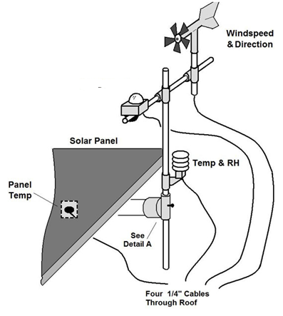
Functional Requirements
Monitor Twitter for tweets @stmguidance using the hashtag #weather
When weather tweet detected, check weather sensors and tweet the current conditions, along with a photo of King Square, at the requestor
example

Slide 3

Example Use Case
From @crimeprophet:
Hey @stmguidance! What’s the #weather?
From @stmguidance:
@crimeprophet current conditions are: temp 5°C, pressure 1002 hPa, humidity 100%, wind 13.0 km/h #CodeSaints

Slide 4
Non-Functional Requirements
Weather proof/Winter proof
Secure from hackers
Responsive
Available – i.e., power & network
Updatable - remotely accessible
Python
Question: Would Ray’s class help us build suitable structure?

Slide 5
Future Enhancements
Detect luminosity
http://www.adafruit.com/products/161
Detect actual precipitation
Smarter responses – e.g., don’t forget umbrella
Time-lapse photos

Slide 6

Interfacing with Twitter
Tweepy API
http://www.tweepy.org/
Need to programmatically tweet
Set up auth codes, connect from Python
Need to monitor for tweets, and automatically respond

Slide 7

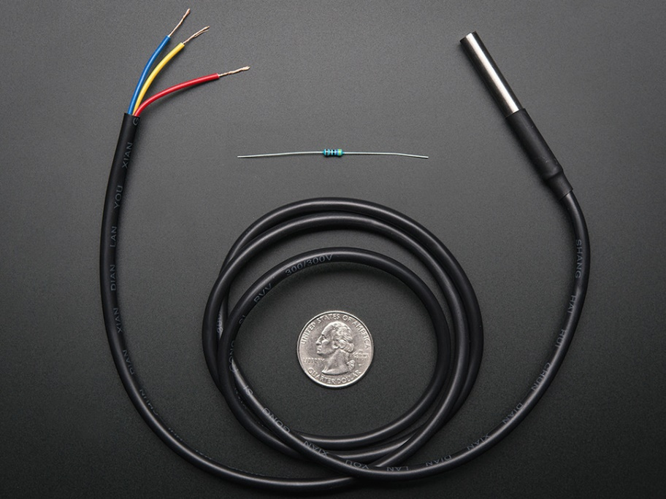
Waterproof DS18B20 Digital Temperature Sensor
Range -55 to 125°C
COST $9.95
http://www.adafruit.com/products/381
No tutorial for Raspberry Pi yet… complex

Slide 8
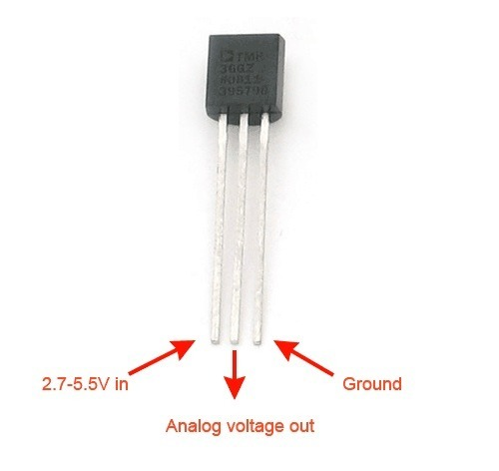
TMP36 Temperature Sensor
Overview
https://learn.adafruit.com/tmp36-temperature-sensor/overview
Range -40 to over +125 degrees C
Tutorial
https://learn.adafruit.com/tmp36-temperature-sensor
COST $1.50
http://www.adafruit.com/products/165
Requires MCP3008 ADC

Slide 9
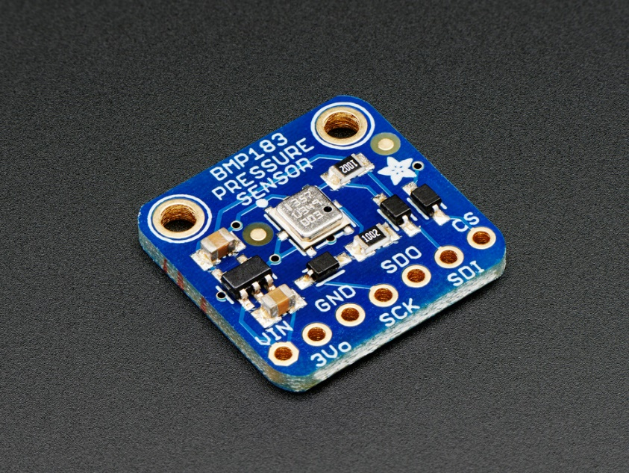
BMP183 SPI Barometric Pressure & Altitude Sensor
Tutorials
https://learn.adafruit.com/adafruit-bmp183-spi-barometric-pressure-and-altitude-sensor
http://forums.adafruit.com/viewtopic.php?f=19&p=285549
COST $9.95
http://www.adafruit.com/products/1900

Slide 10
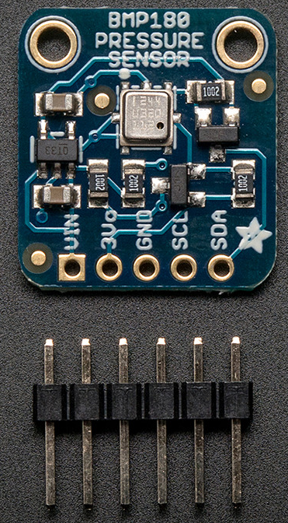

BMP180 Barometric Pressure/Temperature/Altitude Sensor- 5V ready
Tutorial for Raspberry Pi
https://learn.adafruit.com/using-the-bmp085-with-raspberry-pi/overview
COST $9.95
http://www.adafruit.com/product/1603

Slide 11
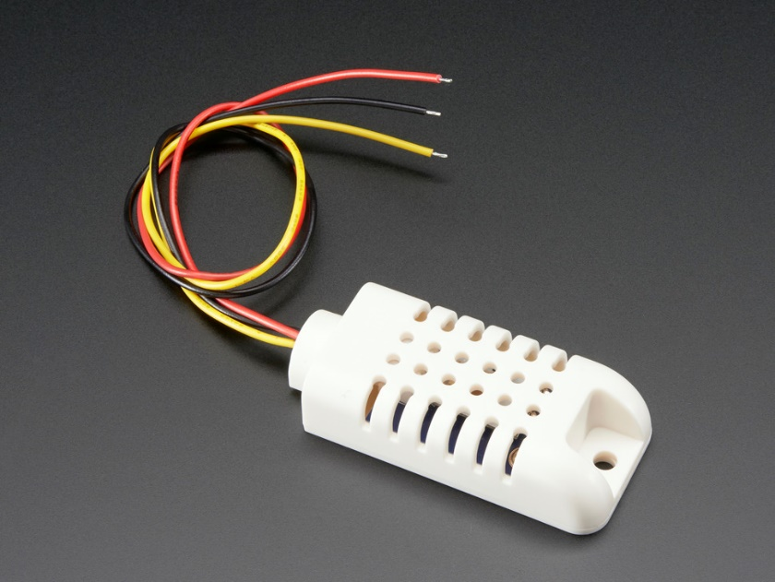
AM2302 (wired DHT22) temperature-humidity sensor
COST $15.00
http://www.adafruit.com/products/393
Good for 0-100% humidity readings with 2-5% accuracy
Good for -40 to 80°C temperature readings ±0.5°C accuracy

Slide 12
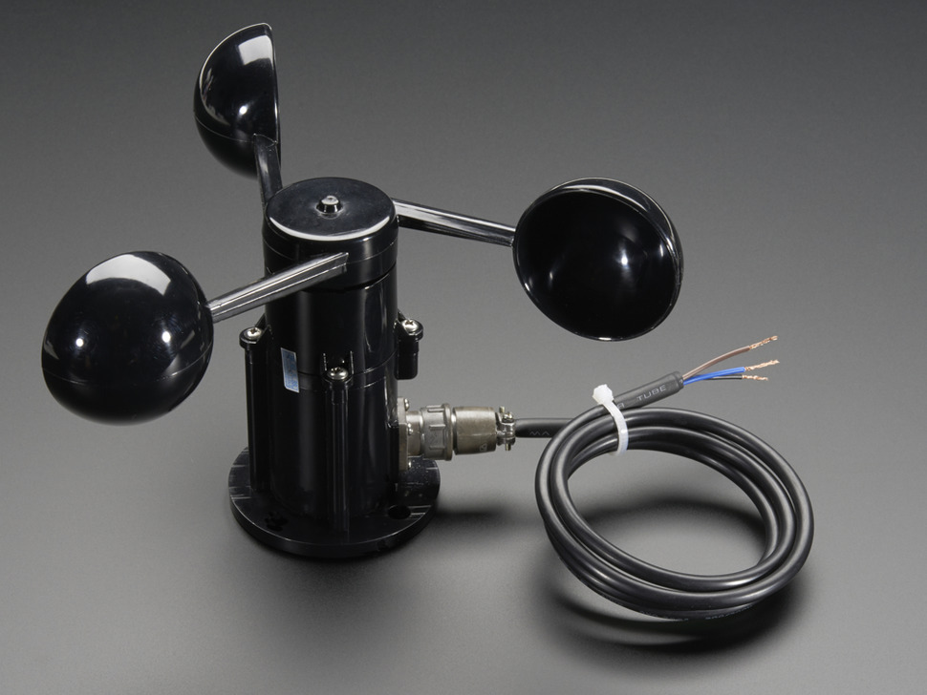
Anemometer Wind Speed Sensor w/Analog Voltage Output
COST $44.95
http://www.adafruit.com/products/1733
Measures in meters per second. Will need to convert to km per hour.
Requires MCP3008 ADC

Slide 13
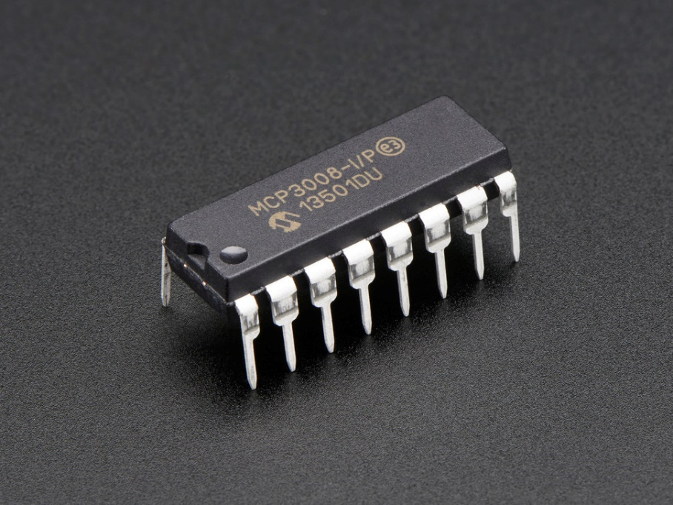
MCP3008 - 8-Channel 10-Bit ADC With SPI Interface
COST $3.75
https://www.adafruit.com/products/856
Tutorials
https://learn.adafruit.com/reading-a-analog-in-and-controlling-audio-volume-with-the-raspberry-pi
https://learn.adafruit.com/send-raspberry-pi-data-to-cosm/connecting-the-cobbler-slash-mcp3008-slash-tmp36

Slide 14
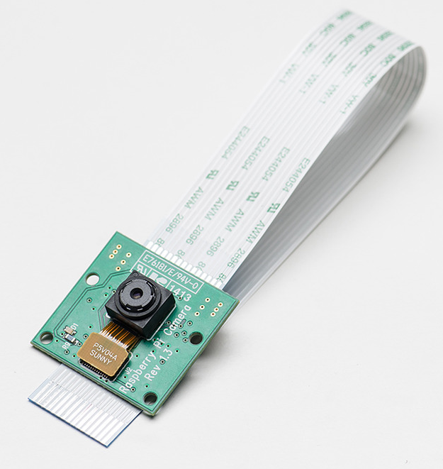
Raspberry Pi Camera Board
Cost $29.95
http://www.adafruit.com/product/1367

Slide 15
Power
If no access to wired power, need reliable battery… possibly solar…

Slide 16
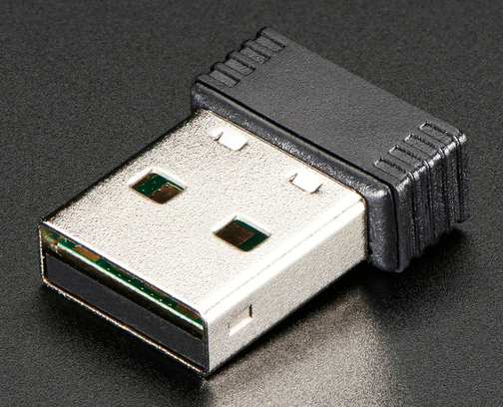
Connectivity - Miniature WiFi (802.11b/g/n) Module
Already tested with Raspberry Pi
Cost $11.95
http://www.adafruit.com/products/814
Or can we get wired connectivity – more reliable/secure.

